Slide 1
Faculty of Nursing Cairo University 2024-2025 Evaluation Course SECOND SEMESTER LEVEL: DOCTORATE
Assignment about
Bloom’s Taxonomy for Each Domain
Under Supervision
Prof. Dr. Effat Mohammed.
Prof. Dr. Enas Helmy
Assist. Prof. Dr. Heba Ahmed

Slide 2
Bloom’s Taxonomy
Bloom’s Taxonomy is a classification of the different objectives and skills that educators set for their students otherwise known as learning objectives. The taxonomy was proposed in 1956 by Benjamin Bloom, an educational psychologist at the University of Chicago. The terminology has been recently updated to include the following six levels of learning. These 6 levels can be used to structure the learning objectives, lessons, and assessments of your course. :

Slide 3
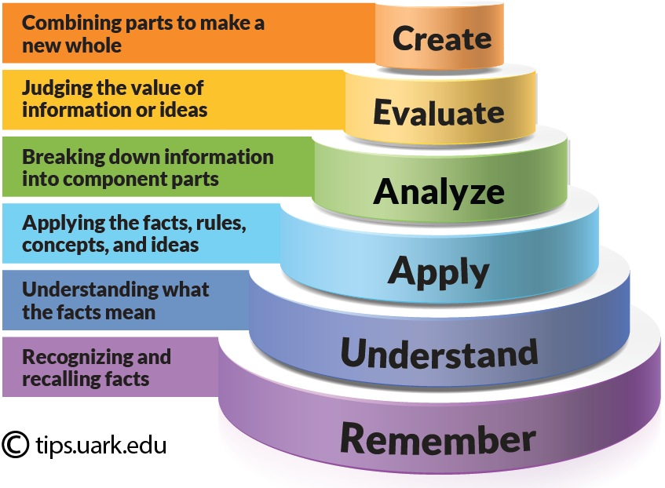

Slide 4
How Bloom’s works with learning objectives
Bloom’s Level | Key Verbs (keywords) | Example Learning Objective
Create | design, formulate, build, invent, create, compose, generate, derive, modify, develop. | By the end of this lesson, the student will be able to design an original homework problem dealing with the principle of conservation of energy.
Evaluate | choose, support, relate, determine, defend, judge, grade, compare, contrast, argue, justify, support, convince, select, evaluate. | By the end of this lesson, the student will be able to determine whether using conservation of energy or conservation of momentum would be more appropriate for solving a dynamics problem.
Learning objective examples adapted from, Nelson Baker at Georgia Tech: nelson.baker@pe.gatech.edu

Slide 5
Bloom’s Level | Key Verbs (keywords) | Example Learning Objective
Analyze | classify, break down, categorize, analyze, diagram, illustrate, criticize, simplify, associate. | By the end of this lesson, the student will be able to differentiate between potential and kinetic energy.
Apply | calculate, predict, apply, solve, illustrate, use, demonstrate, determine, model, perform, present. | By the end of this lesson, the student will be able to calculate the kinetic energy of a projectile.
Learning objective examples adapted from, Nelson Baker at Georgia Tech: nelson.baker@pe.gatech.edu

Slide 6
Bloom’s Level | Key Verbs (keywords) | Example Learning Objective
Understand | describe, explain, paraphrase, restate, give original examples of, summarize, contrast, interpret, discuss. | By the end of this lesson, the student will be able to describe Newton’s three laws of motion in her/his own words
Remember | list, recite, outline, define, name, match, quote, recall, identify, label, recognize. | By the end of this lesson, the student will be able to recite Newton’s three laws of motion.
Learning objective examples adapted from, Nelson Baker at Georgia Tech: nelson.baker@pe.gatech.edu

Slide 8
Cognitive Domain

Slide 9
Example
Differentiate between signs and symptoms of schizophrenia and bipolar disorder using DSM-5 criteria.
level: Analysis (Higher level) → through breaking down complex information and distinguishing between two different conditions as schizophrenia and bipolar disorder to ensure application of knowledge to real-world situations. students must compare and contrast symptoms of schizophrenia and bipolar disorder, rather than just recalling them. They will need to analyze patient cases, identify key symptoms, and apply DSM-5 criteria to correctly classify disorders.

Slide 10
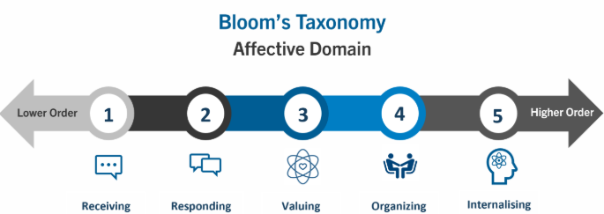

Slide 11
Affective Domain

Slide 12
Example
Advocate for rights of patients with mental illness by educating at least one patient about legal rights at the end of residence in the hospital.
Level: Characterizing (Highest Level) where individuals fully integrate values into their behavior, making them a consistent part of their professional and personal actions.
Nurses is not just learning advocacy but actively incorporating it into their routine practice by educating patients about their rights which aligns with the highest affective domain level.
Characterizing" level, where the behavior is fully ingrained as a core identity.

Slide 13
Psychomotor Domain

Slide 14
Example
Apply crisis de-escalation techniques to manage patient with aggression using verbal and non-verbal techniques in 90% of patients.
Level: Naturalization (Mastering skills effortlessly) → Requires application in real-time scenarios to ensure readiness to handle real psychiatric crises safely and effectively. They can adapt their techniques seamlessly to different patient situations, showing professional expertise.

